Slide 1




NEXT GEN EMPLOYABILITY PROGRAM
Creating a future-ready workforce
Team Members
College Name
Student Name : Shaniha S
Student ID : au960221104109
Arunachala College of Engineering for Women

Slide 2

CAPSTONE PROJECT SHOWCASE
Project Title
Car Rentals Application with Django Framework
Abstract | Problem Statement | Project Overview | Proposed Solution | Technology Used | Modelling & Results | Conclusion

Slide 3
Abstract
Car Rentals is a comprehensive web application developed using the Django framework, designed to streamline the process of car rental management. With an intuitive user interface and robust backend functionalities, Car Rentals offers a seamless experience for both rental agencies and customers. Car Rentals empowers car rental businesses to streamline operations, enhance customer satisfaction, and maximize revenue potential, making it an indispensable tool in the modern rental industry.
Source :

Slide 4
Problem Statement
The car rental industry faces numerous challenges in efficiently managing vehicle inventory, handling bookings, and providing seamless customer experiences. Current systems often lack the necessary features and flexibility to adapt to the evolving needs of rental agencies and customers. As a result, rental businesses struggle with manual processes, outdated technology, and disjointed systems, leading to inefficiencies, errors, and customer dissatisfaction.
Source :

Slide 5
Project Overview
Car Rentals is a comprehensive web application developed using the Django framework, aimed at modernizing and optimizing car rental management for rental agencies and customers alike. The project encompasses various modules and functionalities tailored to address the specific needs and challenges faced by the car rental industry. Overall, Car Rentals aims to revolutionize the car rental industry by providing a modern, efficient, and user-centric platform that meets the evolving needs of rental agencies and customers in an increasingly digital and competitive landscape.
Source :

Slide 6
Proposed Solution
.
The proposed solution is a comprehensive car rentals application built using the Django framework, designed to streamline the process of vehicle rental management for rental agencies and customers. Leveraging Django's robust features and flexibility, the application offers a range of functionalities to effectively manage vehicle inventory, bookings, payments, and administrative tasks. The proposed solution for the car rentals application with Django framework aims to address the challenges faced by rental agencies and customers, offering a modern and efficient platform for managing vehicle rentals. By leveraging Django's capabilities and incorporating key features and components, the application is poised to revolutionize the car rental industry and deliver value to stakeholders.
Key Features and Components:
User Authentication and Authorization: Implement secure user authentication and role-based access control to ensure data privacy and system security . Differentiate user roles such as administrators, rental agents, and customers with customized access levels and permissions.
Source :

Slide 7
2. Vehicle Inventory Management: Develop a centralized inventory management system to add, update, and track vehicles efficiently. Capture detailed vehicle information including make, model, year, availability status, pricing, and additional features.
3. Booking System: Design an intuitive booking interface for customers to search for available vehicles based on their preferences. - Enable flexible booking options with date and time selection, real-time availability checks, and instant confirmation.
4. Reservation Management: Implement reservation tracking and management features, allowing rental agencies to handle bookings, cancellations, and modifications seamlessly. Send automated notifications to users for booking confirmations, reminders, and updates.
5. Payment Integration: Integrate secure payment gateways to facilitate online payments for bookings, ensuring a seamless and secure transaction process . Support multiple payment methods including credit/debit cards, online banking, and digital wallets for customer convenience.
6. Admin Dashboard: Create an intuitive admin dashboard for administrators to manage users, vehicles, bookings, and system settings . Enable real-time updates and alerts for important events and actions to facilitate efficient administration.
Source :

Slide 8
Project Goals:
- Develop a scalable, reliable, and user-friendly car rentals application using Django framework to meet the evolving needs of rental agencies and customers
-Enhance operational efficiency for rental agencies by automating tasks, optimizing resource utilization, and reducing manual efforts.
-Improve customer satisfaction and loyalty by offering a seamless booking experience, transparent pricing, and responsive customer support.
- Ensure data security, privacy, and compliance with regulatory requirements to build trust and confidence among users.
- Drive business growth and competitiveness in the car rental industry by providing a feature-rich and innovative solution that sets new standards for rental management.
The proposed solution for the car rentals application with Django framework aims to address the challenges faced by rental agencies and customers, offering a modern and efficient platform for managing vehicle rentals. By leveraging Django's capabilities and incorporating key features and components, the application is poised to revolutionize the car rental industry and deliver value to stakeholders.
Source :

Slide 9


Technology Used
Front-end
Back-end
Source :

Slide 10
Modelling & Results
Upon completion, the Car Rentals Application with Django Framework will provide rental agencies with a robust and user-friendly platform for managing vehicle rentals efficiently . Users will be able to search for available vehicles, make bookings, process payments securely, and manage reservations seamlessly through the application . The application will offer a responsive and intuitive interface, ensuring a positive user experience across desktop and mobile devices . With features such as reporting and analytics, rental agencies will have access to valuable insights to optimize operations, improve decision-making, and drive business growth . Overall, the Car Rentals Application will deliver tangible benefits to both rental agencies and customers, enhancing productivity, convenience, and satisfaction in the car rental process.
Source :

Slide 11
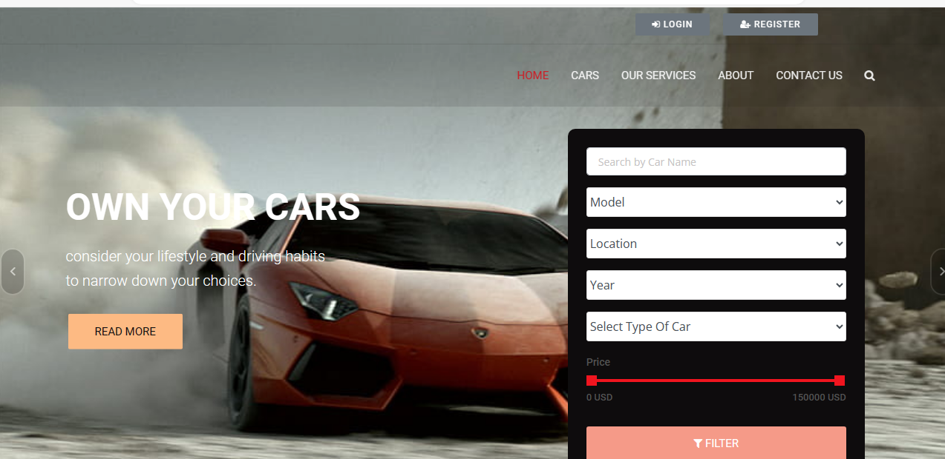
Homepage

Slide 12
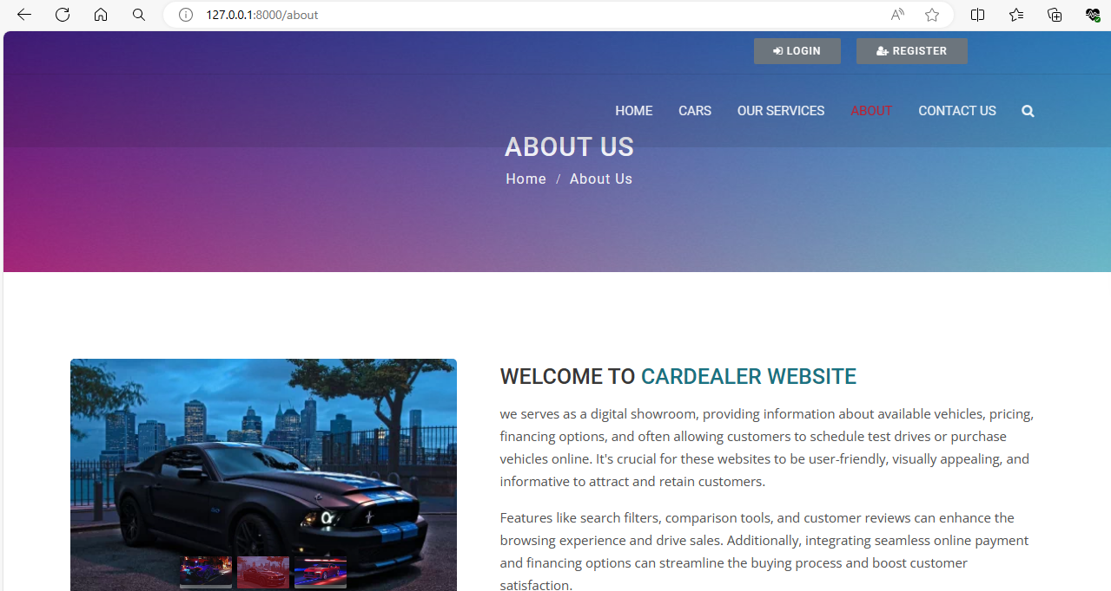
About-Us-Page

Slide 13
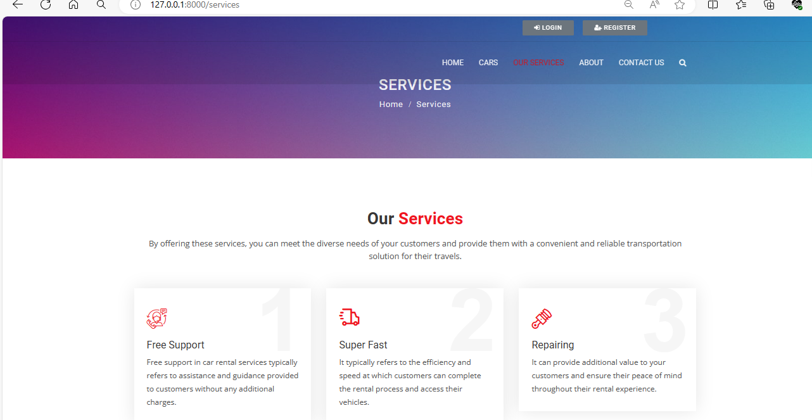
Service-Page

Slide 14
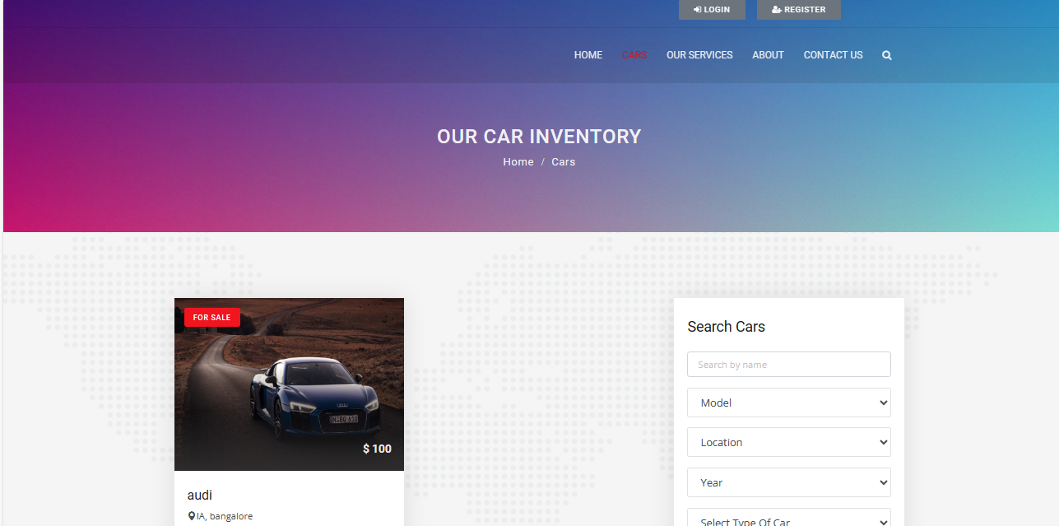
Cars-Page

Slide 15
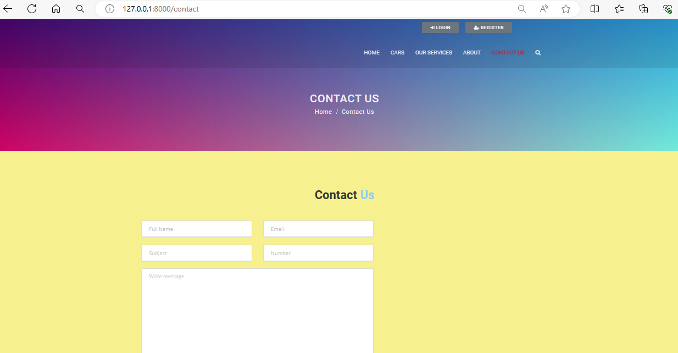
Contact Us-Page

Slide 16
Future Enhancements:
Mobile App Development:
- Develop native mobile applications for iOS and Android platforms to offer a seamless mobile experience for customers.
- Enable features such as GPS navigation, mobile check-in/check-out, and instant support chat for on-the-go convenience.
Integration with IoT Devices:
- Integrate with Internet of Things (IoT) devices installed in vehicles to collect real-time data on vehicle usage, location, and performance.
- Use IoT data to optimize fleet management, monitor vehicle conditions, and enhance customer safety and satisfaction.
Dynamic Pricing Algorithms:
- Implement dynamic pricing algorithms based on factors such as demand, seasonality, and availability to optimize revenue generation.
- Integrate machine learning or predictive analytics models to forecast demand and adjust pricing dynamically in real-time.

Slide 17
Conclusion
Developing a car rentals application using the Django framework offers numerous advantages including scalability, security, and ease of development. By leveraging Django's built-in features such as authentication, ORM, and admin interface, developers can create a robust and user-friendly application. Additionally, Django's extensive ecosystem of packages and libraries provides further flexibility and functionality. With careful planning, thorough testing, and ongoing maintenance, a Django-based car rentals application can deliver a seamless experience for both customers and administrators, contributing to its success in the competitive market of car rental services.
Source :

Slide 18
Thank You!
Notes:
Thank You !!

